Slide 1

雲端新技術：微服務 Microservices

Slide 2

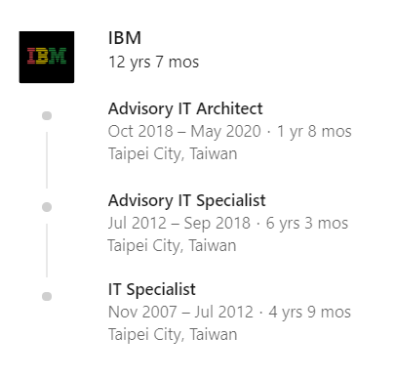
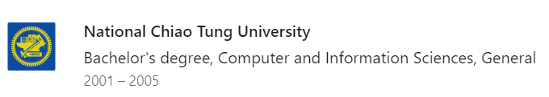









About Me
Vincent Chen 陳彥安
IBM Advisory IT Architect

Slide 3






Contact & Follow Me
Gmail : yachen1023@gamil.com
IBM : yachen@tw.ibm.com
Facebook : https://www.facebook.com/vincent.chen.184007
LinkedIn : https://www.linkedin.com/in/vincent-chen-78232368/
Twitter : https://twitter.com/yachen1023
LINE : yachen

Slide 4
Agenda
1.What are microservices
- What are microservices
- Characteristics of a microservices application
2.Why microservices
- What came before - the monolithic architectural style
- Monolithic vs. Microservice
3.How to get microservices in practice
- Challenges of microservices
- Service mesh
- DevOps
4.When to consider microservices
- The needs for application
5.Where to roll out microservices
- The Cloud

Slide 5
WHAT

Slide 6
Go to the real world

Slide 7
WHY

Slide 8
A monolithic application is like a house:

Slide 9
Once build, you can’t move it!

Slide 10
Monolithic vs. Microservices
Code
Clarity
Deployment
Language
Scaling

Slide 11
Monolithic vs. Microservice
Monolithic
single code base for the entire application
Code
Microservice
Multiple code bases; each microservice has its own

Slide 12
Monolithic vs. Microservice
Monolithic
Can be confusing; hard to maintain
Clarity
Microservice
Better readability; easier to maintain
Notes:
清晰

Slide 13
Monolithic vs. Microservice
Monolithic
Maintenance windows, scheduled downtimes
Deployment
Microservice
Simple; deployed individually, no downtime

Slide 14
Monolithic vs. Microservice
Monolithic
Typically developed in one language
Language
Microservice
Services can be written in different languages

Slide 15
Monolithic vs. Microservice
Monolithic
Scale entire application
Scaling
Microservice
Scale individual services, not entire applications

Slide 16
HOW

Slide 17
Microservice is not a free lunch!

Slide 18
Shift the complexity to operation.

Slide 19
WHEN

Slide 20
When to consider microservices
Flexibility
Scalability
Cost Effective

Slide 21

When to consider microservices

Slide 22
WHERE

Slide 23

Where to roll out microservices

Slide 24

Take away
What are microservices?
Why microservices?
How to get microservices in practice?
When to consider microservices?
Where to roll out microservices?

Slide 25

Reference
Cognitive Class:
https://courses.cognitiveclass.ai/
A Gift from Cognitive Class : $1,200 USD
https://cognitiveclass.ai/ibm-cloud-promotion/
IBM Cloud:
https://cloud.ibm.com/login

Slide 26

We are hiring

Slide 27
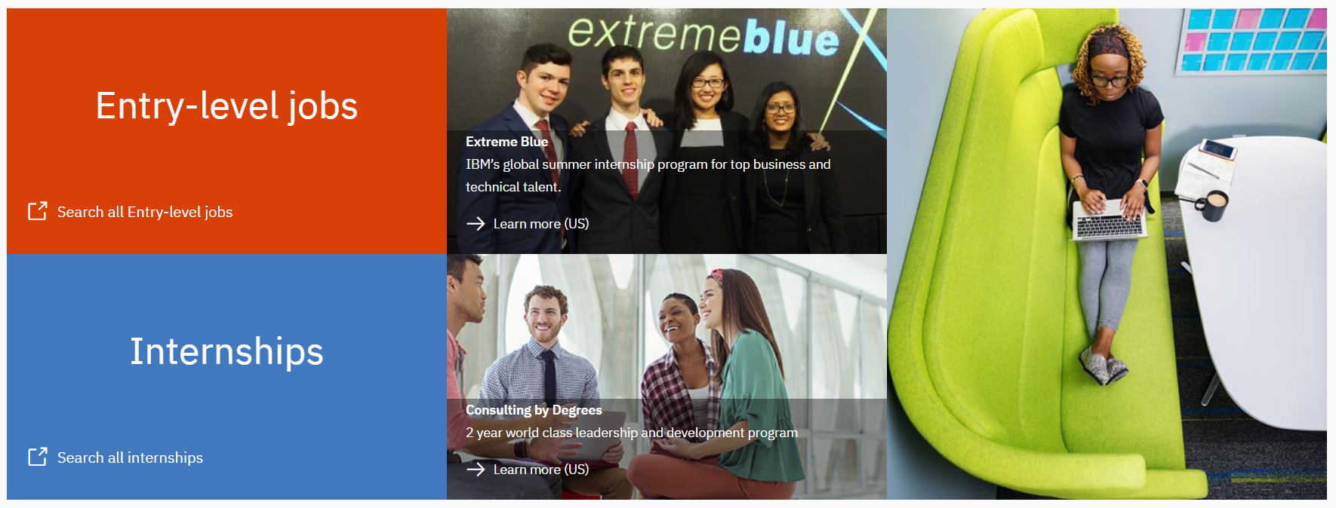
IBM Careers Taiwan
https://www.ibm.com/tw-zh/employment/entrylevel_campus.html

Slide 28
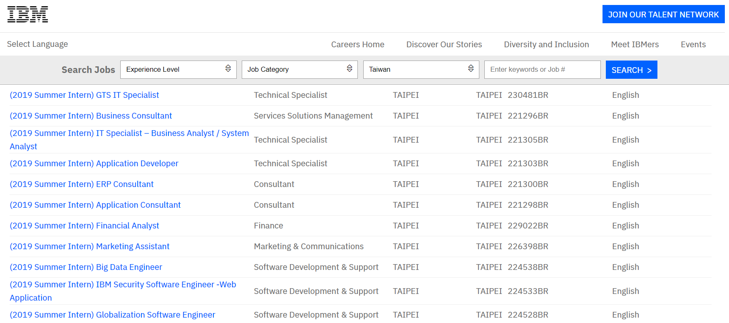
Summer Intern

Slide 29
Thank You

